Slide 1
Wednesday August 21st
You will have advisory every day the first week
8:20- 8:55

Slide 2
If you need an ID:
Go to 1st Floor NEW Building during LUNCH:
Seniors, Monday August, 19 (1st day of school)
Juniors, Tuesday August, 20 (2nd day of school)
Sophomores, Wednesday August 21 (3rd day of school)
OR….anyone during 1st week:
from 8:00-8:15 or 3:45-4:00

Slide 3
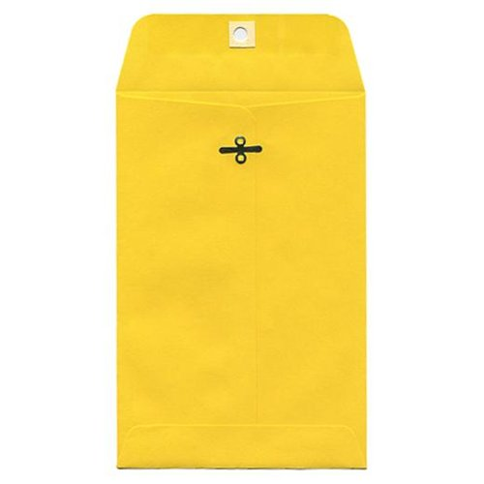
Student Envelopes & Student Handbooks
Keep:
Student Handbook
Parent Information Handbook
Take Home and Return:
DUE to ADVISOR by Tuesday Aug 27th
Application for Meal Benefits
Receipt of Policies
Emergency Contact Form
PTSO Membership Form
PTSO Directory Info
Statement of Responsibility: 1st page of the Student Handbook

Slide 4
FHS Rules Student Handbook pgs. 14-15

Slide 5
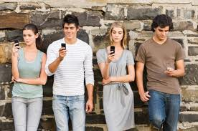
Cell Phones & Electronic Devices
You CAN use your cell phone:
Between class changes and at lunch.
You may NOT use your cell phone:
during class time
in the library
in the main office
assemblies

Slide 6
Cell phones/Electronic Devices
Penalties for mis-use
1st Infraction:
Confiscate phone and student retrieve phone at end of school day from one of the 5 offices.
2nd Infraction:
1st infraction administered AND 3 days detention
3rd Infraction:
Confiscate phone, parent retrieve phone, 1 day of In School Suspension (ISS)
Any additional infractions will result in further disciplinary action.
Refusal to give phone at any time = 3 days In School Suspension (ISS)

Slide 7
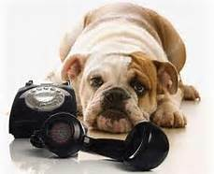
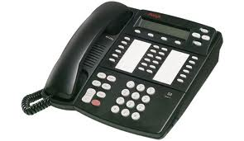
Telephone:
In an emergency, students may use the phone in one of the 5 offices.
Student plans and needs should be handled outside of school hours.
Phase I: Entrance, Purple Office
Phase II: (New Building)
1st, 2nd or 3rd Floor
‘91 Addition: 2nd Floor

Slide 8
Dress Code:
Students must meet dress code throughout the school year including:
Graduation practice
Final Exam Schedules
**Failure to do so:
may hinder graduation practice
will result in taking final exams after school hours

Slide 9
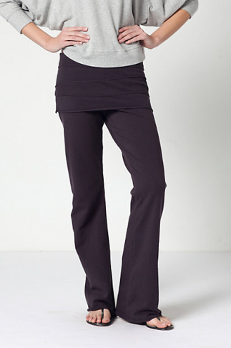
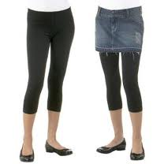
Leggings
&
Yoga Pants
must have hip area covered.
Coverage includes t-shirts, sweaters, skirts, shorts, and dresses of any length that are modest in fitting.

Slide 10
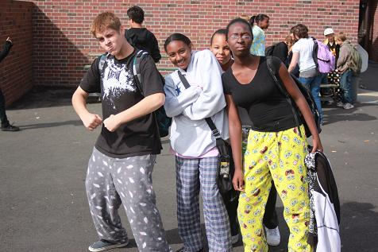
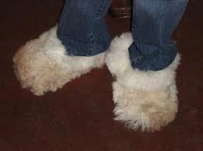
Loungewear
Pajamas
House Shoes
Loungewear

Slide 11
Pants
All bottom clothing must be worn at waist level
shorts
pants
skirts/dresses
Sagging is not allowed (AR law Act 835)
Clothing with holes, rips or tears above mid-thigh are NOT permitted.
Clothing with holes should not reveal inappropriate skin or expose undergarments.

Slide 12
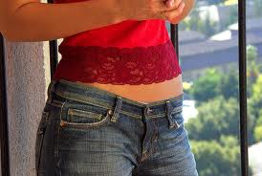
Shirts
Must meet the 3 fingertip coverage rule:
NO spaghetti Straps
NO halter tops
NO mesh tops, sheet blouses and see through shirts
NO muscle shirts
NO low cut arm holes
No shirts worn with one shoulder bare or shoulder exposed
Backs must be covered
No revealing midriff
No cleavage (AR Law Act 835)
Sheer blouses are acceptable with under garment coverage
that meets school dress code.

Slide 13
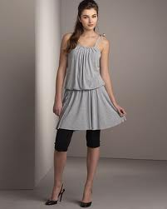
Shorts/ Skirts/Dresses
Must be modest in length, appearance and fit.
*A standard acceptable is a garment worn at waist
level that reaches no more than six inches above
the knee or the length or a dollar bill.
Skirts or dresses that are shorter than mid thigh can be worn with leggings, but must be modest in nature.

Slide 14
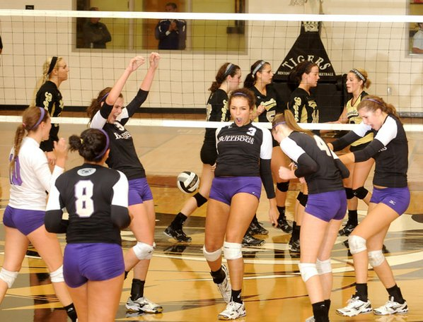
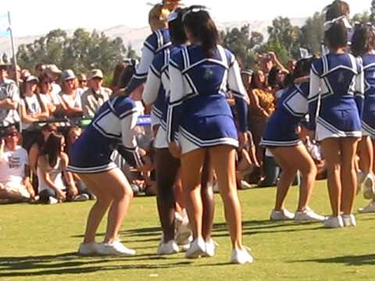
School Uniforms
Must meet dress code except during designated school performances

Slide 15
Offensive Clothing
NO clothing, hats or backpacks shall include:
alcohol, drugs, tobacco or tobacco products
violence
hate themes
racial/gender degradation
sexually explicit or suggestive wording or pictures
gang affiliation or gang tattoos
gang monikers
promotes illegal activity
clothing to cause a disruption within the school environment.

Slide 16
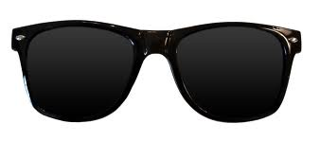
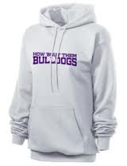
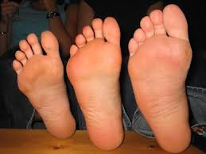
Other….
No long belts, spiked accessories, sunglasses or bandanas
No tattoos displaying defamatory writing , racist, obscene language or symbols, or symbols of drugs, sex or alcohol
No bare feet in the interest of safety and hygiene.
Hoodies and costumes when worn must reveal the identity of student

Slide 17
Dress Code Violations
1st Offense: Warning, Correct the attire, administrator phone parent
2nd Offense: Correct that attire, Saturday School, administrator phone parent
3rd Offense: Correct the attire, Saturday School, Parent conference with administrator
4th Offense: Correct the attire, one day of ISS
Repeated offenses will result in further and more punitive disciplinary action.

Slide 18
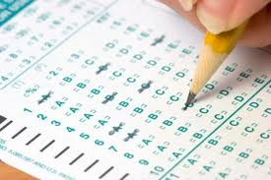
Dress Code Violations
Detention: Dress code violations for items that can be adjusted
(sagging pants, exposed cleavage)
Students who are unable to correct their attire, MAY be placed in:
Study Hall/ISS and will remain until he or she is able to change OR parent brings a change of clothes. Failure to report to study hall may result in Saturday School.
Note:
Absences due to dress code violation will count toward criteria for final exam exemptions.
Absences will weigh similar to ISS or OSS. It will be coded as “ABS” with a memo that reads “dress code violation.” These hours may not be counted as excessive absences.

