Slide 1
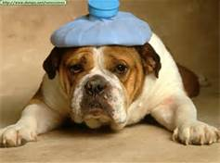
Friday August 23rd
Juniors
Seniors
Sophomores
Staff

Slide 3
Things to Know…..
Announcements
The Pledge of Allegiance (daily)
Moment of Silence (daily)
Read over intercom
Deliveries
Flower, balloon, candy or food deliveries to students are NOT allowed
Hall Passes
MUST be used
Messages
Only accepted if pre-approved by principal

Slide 4
Other Things to Know…..
Petitions
May not be circulated on school property or at school related activities unless
prior approval has been granted by administration
School Visitation
All visitors must sign in at the PURPLE OFFICE. Visitor’s ID will be scanned using the new Hall Pass system and the ID badge must be worn at all times.
Students are not allowed to bring children or pets to school
Student visitors not allowed
ID’s
Will be required for participation in many campus events such as lunch, library, ticket sales, etc.
Replacement cost is $5 for new ID

Slide 5
Tuesday – Wednesday – Thursday September 3rd –May 23rd 7:30-8:15 and 4:00-4:45
Testing Center
Available for students who missed an exam from their regularly scheduled course.
Teachers can request students make up an exam in this environment.

Slide 6
Semester Grading System
Final grade for Semester based on:
80% Entire semester daily average
20% Final Exam
Semester Grades used to compute GPA and Class Rank
Class Rank is Calculated End of Junior Year
End of 1st Semester Senior Year
End of 2nd Semester Senior Year
Classes with excessive absences will have an “NC” on transcript to indicate No-Credit.
If the student receives an “F” in the course, that grade will be factored into GPA calculation

Slide 7
Credits and Class Status
Sophomores = 5 Credits
Junior = 10 Credits
Senior = 16 Credits
To Graduate you must have completed 24 Credits
based on state and local graduation requirements.

Slide 8
Dates you might want to remember……...
1st Semester:
1st Quarter (41 days): ends October 16th
End of First Semester (41 days): December 20th
2nd Semester:
Beginning of 3rd Quarter: January 6th
3rd Quarter (48 days): ends March 13th
End of Second Semester (48 days): May 30th
Spring Break: March 24th – 28th

Slide 9
Credit Recovery Program….3 Options
Credit Recovery Class on student’s schedule
Students can earn 1.0 credits per semester with a maximum of 2.0 credits per year.
Student will be limited to enroll in one period of Credit Recovery during a school year without special approval by an administrator .
Night School
Credit Recovery Only
Night school meets Tuesday and Thursday from 4:00-6:00 PM
Apply online at www.fayar.net/fhsprograms, select Night School Program
Summer School
A maximum of one (1.0) credit may be earned each summer.
The dates and times will be announced during the last nine weeks of school.
Apply online at: www.fayar.net/fhsprograms , select Summer School Program

Slide 10
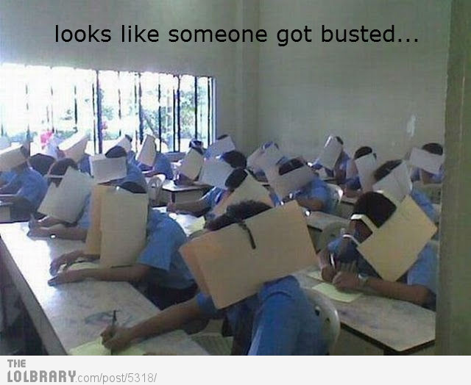
Academic Integrity/Honor Code

Slide 11
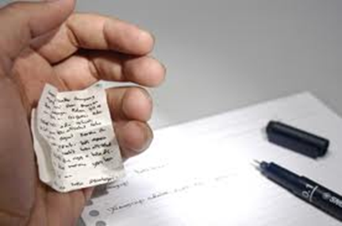
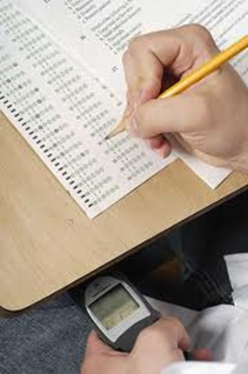
Sharing Your Work
Looking at someone else’s paper
Unauthorized Technology
Cheat Notes
Passing on Info from Test
Plagiarizing
Considered 2nd Infraction Category:
Making copies of tests/assignments
Receiving Copies of tests/assignments
Stealing a test or answer sheet
Stealing teacher edition’s of textbooks
Selling test or information about any test/project

Slide 12
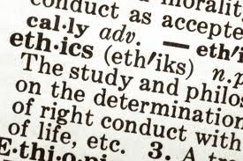
Consequences
1st Infraction:
Student will receive a zero
Teacher will notify parents
Recommendation for dismissal from any FHS honor societies
Referral to administrator
2nd Infraction:
Student will receive a zero
Teacher will notify parents
Dismissal from the NHS (if member)
Student will not be eligible to be Honors Graduate
2 Days of In School Suspension
3rd Infraction:
Considered serious violation and will be treated accordingly
Student will receive no less than the consequences for the second violation and possible recommendation for dismissal from class in which 3rd infraction occurs.

Slide 13
Discipline Types
Classroom Behavior Rules:
Teacher Assigned Detentions “A Lunch”
Skipping Classes or Assemblies:
Considered truant under attendance policies
School personnel may apply the minimum amount of force necessary to stop or restrain a student from conduct that could result in his/her physical injury or injury to others.
Suspicion Search and Seizure

Slide 14
Discipline Issues
Drugs/Alcohol
Use/Possession of drugs, anabolic steroids,
alcohol, inhalants, analogues or other controlled
substances
Gambling
Not permitted on or around school campus, bus, or any school
related activity. Includes “pools” such as betting on college or pro
games
Tobacco:
Tobacco products (including smokeless tobacco) or paraphernalia
related to its use. Students are not allowed to cross the street and
smoke in-between classes. This is considered truancy.
Insubordination:
Failure to comply with stated rules and regulations and/or the
reasonable request, directions, or commands of a school employee.

Slide 15
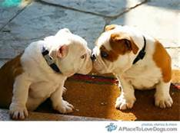
Discipline Issues
Public Displays of Affection (PDA)
Inappropriate at school
Reasonable Suspicion/Search and Seizure
School personnel may search and seize contraband. Searches on lockers,
book bags, car etc. may be held at any time a reasonable suspicion exists.
Lockers are joint property of the school and the individual and therefore
subject to searches.
Conduct and Sportsmanship at School-Sponsored Activities:
Student conduct during school-sponsored activities, on and off campus,
will be governed by the same rules that apply to general student conduct.

Slide 16
Consequences
Detention
Begins five minutes after 4th period ends
If you are late you will not be admitted
Can’t talk or sleep
Takes priority
Saturday School
Held in the FHS Cafeteria from 8 – 12
If you are late you will not be admitted
* If school is canceled due to bad weather on Fri, no Sat school
In-School Suspension
Will receive all make-up work and assignments
Completed work returned to teacher through main office
May be suspended from school activities that day

Slide 17
Consequences
Out of School Suspension (OSS)
Assigned for serious violations of school rules
May not participate or attend any school activities during suspension
May make up assignments for first 10 days of OSS
Student must collect assignments
Work is DUE UPON RETURNING TO SCHOOL
You must participate in school activities/assignments/tests when you return
Expulsion
Removing a student from school on a permanent basis
Length can vary
Must be expelled by Fayetteville Board of Education

Slide 18
Bullying – District Policy 5.47
Intentional harassment, intimidation, humiliation, ridicule, defamation, or threat or
incitement of violence by a student against another student or school employee by a written, verbal, electronic or physical act …………that causes or creates:
Physical harm to employee or student, damage to the school, employee or student property.
Substantial interference with a student’s education or with a school employee’s role in education
A hostile environment for one or more students due to severity, persistence or pervasiveness of
the act.
Substantial disruption to the orderly operation of the school or education environment.

Slide 19
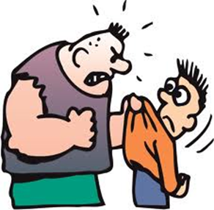
Bullying is Prohibited:
On school grounds
With school equipment
Off school grounds at a school sponsored activity or event
Going to or from school or a school activity
While being transported in school by vehicles, on school bus or bus stop
By an electronic act which results in the substantial disruption of the orderly operation of the school environment.
REPORT TO TEACHER,
PRINCIPAL OR DESIGNEE
Consequences include but are not limited to:
School requested parent/guardian conference
Up to 10 days of suspension
Referral to pre-expulsion hearing committee, with expulsion up to one year

Slide 20
Get Involved

Slide 21
Club Fair will be September the 11th during LUNCH in the Phase I Arena Lobby
Club list | Meeting days
26 Club* | Tues
ACE/Knowledge Master* | Wed
Art Club | Mon
Astronomy Club | Wed
Bulldog Partners | Mon
Chess Club | Tues
Christian Book Club* | Thurs
DECA | Wed
Driver Safety* | Mon
Fantasy Club | Wed
Fashion Club | Thurs
FBLA | Tues
FCA - Fellowship Christian Athlete* | Wed
FCCLA* | Tues
Food/Hangook Cult Club* | Wed
French Honor Society | Thurs
German Honor Society | Mon
Green Team | Tues
GSA* | Mon
Key Club* | Tues
Model UN* | Mon
Mountain Bike Club | Tues
Mu Alpha Theta | Thurs
NHS | Wed
PBS | Thurs
Philosophy Club | Thurs
Project Graduation | Thurs
Quill and Scroll | Tues
Rubik’s Cube Club | Tues
Science Club | Tues
Teachers of Tomorrow | Thurs
Thespian Society | Thurs
Video Club | Thurs
VIP | Mon
World Language Club | Mon
Young Dem & Liberals | Mon
Young Republicans | Thurs
2013-2014 S.M.A.R.T. Lunch Club and Activities Calendar
1st Monday Model UN GSA | 1st Tuesday 26 Club, Key Club Disc Golf Club Green Team Rubik’s Cube Club | 1st Wednesday Astronomy Club DECA Food Club / Hangook | 1st Thursday Young Republicans Christian Book Club French Honor Society Fashion Club | 1st Friday
TGS Priority: Social Studies, Fine Arts and ESL | TGS Priority: Math, Health/PE And CTE | TGS Priority: English, Advanced Placement SPED | TGS Priority: Science and World Languages
Intramurals , Aux Gym “A” and “B” Lunch | Intramurals , Aux Gym “A” and “B” Lunch | Intramurals , Aux Gym “A” and “B” Lunch | Intramurals , Aux Gym “A” and “B” Lunch | Intramurals, Aux Gym Free Play “A” and “B”
2nd Monday Driver Safety Young Dem and Liberals VIP | 2nd Tuesday 26 Club Chess Club Quill and Scroll FCCLA | 2nd Wednesday ACE/Knowledge Master FCA | 2nd Thursday Project Graduation Christian Book Club Thespian Society PBS Teachers of Tomorrow | 2nd Friday
TGS Priority: Social Studies, Fine Arts and ESL | TGS Priority: Math, Health/PE And CTE | TGS Priority: English, Advanced Placement SPED | TGS Priority: Science and World Languages
Intramurals , Aux Gym “A” and “B” Lunch | Intramurals , Aux Gym “A” and “B” Lunch | Intramurals , Aux Gym “A” and “B” Lunch | Intramurals , Aux Gym “A” and “B” Lunch | Intramurals, Aux Gym Free Play “A” and “B”
3rd Monday Model UN Bulldog Partners World Language Club GSA | 3rd Tuesday 26 Club Key Club Mountain Bike Club FBLA | 3rd Wednesday NHS Fantasy Club | 3rd Thursday Mu Alpha Theta Christian Book Club | 3rd Friday
TGS Priority: Social Studies, Fine Arts and ESL | TGS Priority: Math, Health/PE And CTE | TGS Priority: English, Advanced Placement SPED | TGS Priority: Science and World Languages
Intramurals , Aux Gym “A” and “B” Lunch | Intramurals , Aux Gym “A” and “B” Lunch | Intramurals , Aux Gym “A” and “B” Lunch | Intramurals , Aux Gym “A” and “B” Lunch | Intramurals, Aux Gym Free Play “A” and “B”
4th Monday Art Club Driver Safety German Honor Society | 4th Tuesday 26 Club Science Club FCCLA | 4th Wednesday ACE/Knowledge Master FCA | 4th Thursday Video Club Christian Book Club Philosophy Club | 4th Friday
TGS Priority: Social Studies, Fine Arts and ESL | TGS Priority: Math, Health/PE And CTE | TGS Priority: English, Adv Placement and SPED | TGS Priority: Science and World Languages
Intramurals , Aux Gym “A” and “B” Lunch | Intramurals , Aux Gym “A” and “B” Lunch | Intramurals , Aux Gym “A” and “B” Lunch | Intramurals , Aux Gym “A” and “B” Lunch | Intramurals, Aux Gym Free Play “A” and “B”
Irregular groups, to be scheduled around existing calendar, Monday-Thursday of any week: Dawg Crew, Debate/Forensics Club, Jazz Band, Register Newspaper, Sociedad Honoraria Hispania, Young Life, FFA, Music Volunteering, Nat Forensic League, StuCo, Fire Marshals. Regular Activities (not clubs) include groups such as the Gaming Group and the Knitting Circle – to be scheduled.
“A” Lunch

Slide 22
Athletic Programs
7A West Conference Schools:
Bentonville, Fayetteville, Har-Ber, Heritage, Rogers, Siloam Springs,
Springdale and Van Buren
Fall/Winter:
*Cross Country
Football
Volleyball
*Golf
*Swimming
*Basketball
*Bowling
Spring:
Baseball
Fast Pitch Softball
*Track
*Tennis
*Soccer
*Wrestling
* Boys and Girls

Slide 23
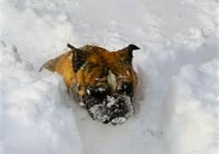
SNOW DAYS!!!
Inclement Weather
School Cancellation no later than 7:00 a.m.
fayar.net
local radio stations
local TV stations

Slide 24
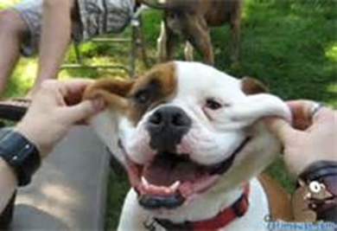
Have a Great Weekend!

