Slide 1
FPS Food Drive
October 28- November 22

Slide 2
Where does my donated food go?
Families in Transition
To fill food baskets given out by the Outback, the building holding all the collected food, for Thanksgiving and Winter Break
Baskets given to students and families in our school district

Slide 3
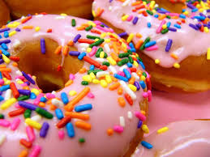
SLC Competition
This year all SLCs are competing against one another for the SLC cup!
For the Advisory class collecting the most food
Donut party in advisory
A prom ticket to be raffle off in class

Slide 4
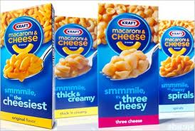
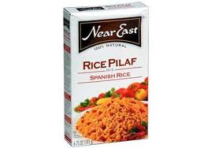
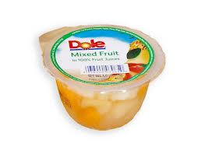
What should I bring?
Non-perishable foods!
Peanut butter
Corn
Fruit cups
Rice
Macaroni and cheese
Foods you like to eat!

Slide 5
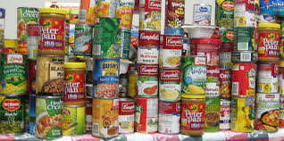
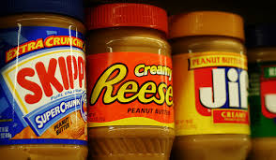
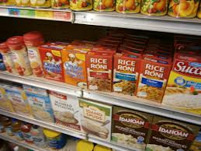
Points for your Advisory
Peanut butter is 3 points
Boxed food is 2 points
Canned food is 1 point

Slide 6
Winning SLC
The winning SLC will receive the SLC House cup to display to prove your SLC is the best!

Slide 7
collection of food
You can bring food any day!
Primary collection days are Tuesday and Thursday
All food is to be brought to your advisory teacher during advisory

Slide 8
Up coming events…
Homeless vigil
December 6th
Blood drive
December 7th

