Slide 1
You will have advisory
every day the first week

Slide 2
SCHEDULES
If your schedule is LIGHT BLUE it means
YOU HAVE NOT completed PROOF OF RESIDENCY
Bring one of the following items to the COMMONS ASAP
Water Bill
Gas Bill
Electric Bill
Signed Current Lease Agreement
Due date must be after July 1st
You WILL NOT be allowed to attend classes
after Friday, August 23rd if you fail to meet this requirement.

Slide 3
Student Envelopes & Student Handbooks
Keep:
Student Handbook
Parent Information Handbook
Take Home and Return:
DUE to ADVISOR by Tuesday Aug 27th
Application for Meal Benefits
Receipt of Policies
Emergency Contact Form
PTSO Membership Form
PTSO Directory Info
Statement of Responsibility: 1st page of the Student Handbook

Slide 4
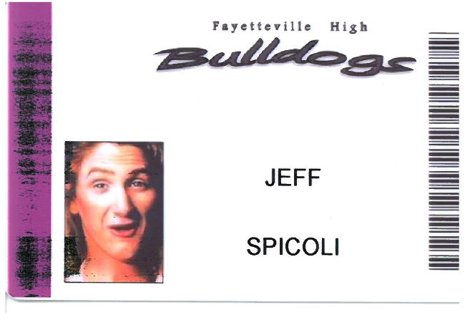
Student ID’s
Barcode is your
student ID #
purple = 12th
Blue = 11th
Green = 10th
LUNCH: Don’t forget your ID
or back to the end of the line you go!

Slide 5
What if YOU don’t have an ID??
Go to 1st Floor NEW Building Reception area:
Seniors, Monday August, 19 (1st day of school)
Juniors, Tuesday August, 20 (2nd day of school)
Sophomores, Wednesday August 21 (3rd day of school)
OR….anyone during 1st week:
from 8:00-8:15 or 3:45-4:00

Slide 6
Studentt SMART Lunch
11th & 12th Grade “A”
10th Grade “B”

Slide 7
What can you do if you are not leaving campus?
Eat Lunch Shift A
Go to the Outdoor Front Entry steps to eat or socialize
Go back into the hallways in Area 91 or the commons area in the newer buildings.
Students will be allowed to take food from the cafeteria, however, you
May NOT eat in the hallways of the newer buildings
Participate in or watch intramural activities in the auxiliary gym.
NO FOOD OR DRINK allowed
Go to the Library or Computer Lab….. NO FOOD IS ALLOWED
Go to the North Green Area between the Bulldog Lobby Entrance and the parking lot. No going into the parking lot!
Go to a Teacher Guided Study

Slide 8
10th and 11th Grade Schedule Changes
1st Semester ONLY
Requests must be completed online by August 23rd www.fayar.net/fhsprograms
Request must meet one of the following criteria:
Gap in my schedule.
Haven’t met the prerequisite for the course
Student has already taken course and received credit.
Any other reasons will be considered a special circumstance. . .

Slide 9
Special Circumstance Schedule Changes
Forms Available Through:
Counselor
Downloading online: www.fayar.net/fhsprograms
Select: Special Circumstance Schedule Request Form
FORM must be turned into Hannah Fleming by August 23rd
2nd Floor Office Phase 2 building

Slide 10
Students MUST continue
to attend the classes on the original schedule until they have been notified
by a school official
of an approved schedule change.

