Slide 1
GEAR UP CORE Teacher Academy 12 th Grade Science - ES
Workshop #46706
August 1 – August 3, 2016

Slide 2
Agenda Day 1
8:30-9:00 a.m. GEAR UP Welcome
Complete GEAR UP- Pre Survey
Science http://goo.gl/forms/nghXqiLNRR9GBcIc2
9:00-11:30 a.m. TI-Nspire CX – ES
11:30 a.m.-12:45 p.m. Lunch on your own
12:45-4:00 p.m. TI-Nspire CX – ES

Slide 3
Do’s and….
Do
ask questions
make suggestions
share with others
Don’t
hold back
limit yourself

Slide 4
Welcome
Purpose – focus on instructional strategies and activities utilizing TI-Nspire CX technology that will help prepare GEAR UP cohort ES students for college and career readiness.

Slide 5
Facilitators
TI rep – TI-Nspire and software license David A. Young 479-236-1476 dayoung7@gmail.com
Science specialist – Correlating activities to Environmental Systems TEKS Yuridia Patricia Gandy, M.S. 956-984-6153 ypgandy@esc1.net
TI Education Website – education.ti.com

Slide 6
Web Page Support
militantgrammarian.com/DAY/DwD/Workshops/BOOST_ESC1/ES1516.htm

Slide 7
TI-Nspire Teacher Software
Look for shortcuts on desktop
Start software

Slide 8
TI Education Website
www.education.ti.com
Point to Activities tab
Click on Science Nspired
Explore…
Point to tab
Click on Student and Parent Resources
Click on Learn More
Product Tutorials

Slide 9
Look for handout located in your binder.
Follow the instructions on the handout.

Slide 10
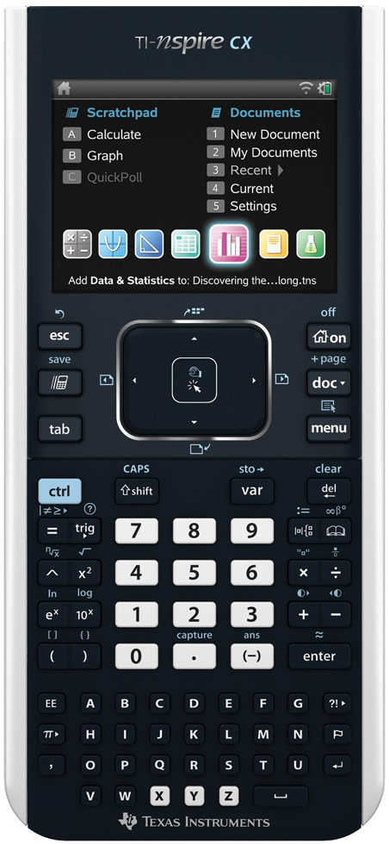
Let’s meet the TI-nspire CX
Turn on your CX
TI-Nspire CX Scavenger Hunt
What Makes An Animal?
Introduction to Data Collection
Like Moths Around a Flame
Not a Touch Screen

Slide 11
Data Collection
Meter View
Time-based
Rate of change – two point
Events with Entry

Slide 12
Let’s meet the TI-nspire CX
PM- Activities
Which Fish?
Hare Today. Gone Tomorrow
Biodiversity- Bell Ringer
Biodiversity and the Environment
Not a Touch Screen

Slide 13
Have a Great rest of the day. See you tomorrow
Be sure to bring your laptops tomorrow!

Slide 14
Welcome Back! Everyone check in outside?

Slide 15
Agenda Day 2
8:30 am. -11:30 a.m. TI-Nspire CX – ES Activities
11:30 a.m.-12:45 p.m. Lunch on your own
12:45 p.m. - 4:00 p.m. TI-Nspire CX – ES Activities

Slide 16
Activities Day 2
Artic Wars-Lynx vs. Snowshoe Hare
Temperature Regulation – Bell ringer
Too Hot? Too Cold? Just Right
Watch the Birdie-Breathe!
Recipe for a Living World
When Water Leaves!

Slide 17
Welcome Back! Everyone check in outside?

Slide 18
Agenda Day 3
8:30 am. -11:30 a.m. TI-Nspire CX – ES Activities
11:30 a.m.-12:45 p.m. Lunch on your own
12:45 p.m. - 4:00 p.m. TI-Nspire CX – ES Activities

Slide 19
Review Exit Slips

Slide 20
Creating a TNS file
Create New Document on computer
Split screen – Title/Image
MC – single response – self-check
Copy/Paste in page sorter view
Move pages in page sorter view
Share file with two others and discuss

Slide 21
Exit Survey
Look for Exit Slip for
Please fill it out
As honestly as possible ☺

