Slide 1
TI-Nspire™ CX Family Overview

Slide 2
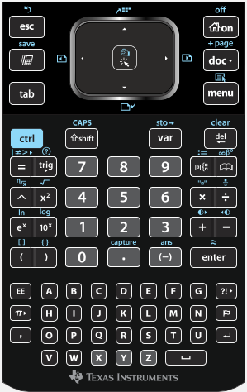
14
1
2
3
13
4
12
5
11
6
10
7
9
8
Notes:
The keypad has two main regions: the NavPad at the top and the keyboard at the bottom. The navpad acts as both a cursor controller and a mouse controller. The button at the center of the Navpad is the mouse click button and is also used for ‘grabbing’ objects to move them around. There are also four blue symbols around the edge of the NavPad that we’ll use later.

Slide 3
14
Escape
(Undo)
1
Touchpad
2
“Click”
(Grab)
3
Home
(Off)
13
Scratchpad
(Save)
4
Document
Tools
(Add Page)
12
Previous
Page
5
Next
Page
11
tab
6
Menu
(Context Menu)
7
del
10
ctrl
9
shift
8
var
Notes:
The keypad has two main regions: the NavPad at the top and the keyboard at the bottom. The navpad acts as both a cursor controller and a mouse controller. The button at the center of the Navpad is the mouse click button and is also used for ‘grabbing’ objects to move them around. There are also four blue symbols around the edge of the NavPad that we’ll use later.

