Slide 1
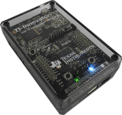
Science through Engineering Design
Incorporates engineering design into middle grades science lessons so that students can investigate concepts
Engaging storylines make mathematics and science concepts relevant and compel students to learn
Students use mathematics that is on grade-level to solve problems
Uses components provided in the TI-Innovator™ Science Pack
+
+
TI-Innovator™ Hub
TI-Innovator™ Science Pack
TI-Nspire™ CX
TI-Nspire™ CX CAS
Notes:
Point out that in the 15 states that have adopted the NGSS engineering design is part of the standards.
As of April 4, 2016 NGSS states include: CA, OR, WA, HI, NV, KS, IA, IL, KY, WV, MD, NJ, CT, RI, VT

