Slide 1
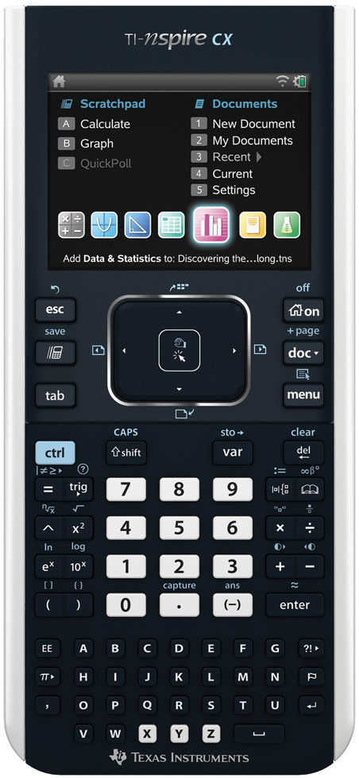
Welcome Back! Everyone check in outside?

Slide 2
GEAR UP CORE Teacher Academy 10th Grade Chemistry
Workshop #42958
May 22nd – May 24th 2014

Slide 3
Agenda
Welcome
Introductions
Homework from May
Measurement Lab
English to Metric Lab
Dimensional Analysis activity
Polymer Gel Cube Lab
Revisit Boyle’s Law

Slide 4
Do’s and….
Do
ask questions
make suggestions
share with others
Don’t
hold back
limit yourself

Slide 5
Welcome
Purpose – focus on instructional strategies utilizing TI Nspire CX technology that will help prepare GEAR UP cohort students for college and career readiness.

Slide 6
Facilitators
TI Instructor
Science specialist

Slide 7
TI-nspire CX
Just a reminder ☺
Not a Touch Screen

Slide 8
Measurement Lab
Use paper rulers and duck square
Measurement Lab handout

Slide 9
English to Metric lab
Activity

Slide 10
Dimensional Analysis Activity
Dimensional Analysis handout

Slide 11
Polymer Gel Cube Lab
Handout

Slide 12
Revisit Boyle’s Law
Handout

Slide 13
Questions

Slide 14
Have a Great rest of the day. See you tomorrow

Slide 15
Welcome Back! Everyone check in outside?

Slide 16
Agenda
Different Question Types
Create a Self Test
Where is the Heat? simulation
Penny lab
Build an Atom simulation
Radioactive Decay lab
Radioactive Dating Game simulation
Nuclear Decay/Chain Reactions simulation
Electron Configuration simulation
Periodicity of Properties simulation
Ways to teach Electron Configurations

Slide 17
Question Types
Multiple choice
Checkbox
Text match
Numerical expression
Image (point on)
Chemistry

Slide 18
Create a Self Test
For Physical and Chemical Changes
Two of each using multiple choice and checkbox
Share

Slide 19
Where is the Heat? simulation
Handout
Notes:
Follow information in handout

Slide 20
Penny Lab
Penny For Your Thoughts handout
Pennies
Notes:
Follow information in handout

Slide 21
Build an Atom
Handout

Slide 22
Radioactive Decay lab
Handout
M&Ms

Slide 23
Radioactive Dating Game
Handout

Slide 24
Nuclear Decay/Chain Reactions
simulation
Notes:
Follow information in handout

Slide 25
Electron Configurations
Simulation

Slide 26
Periodicity of Properties
simulation

Slide 27
Discussion
Ways to teach Electron Configurations?

Slide 28
Questions

Slide 29
Have a Great rest of the day. See you tomorrow

Slide 30
Welcome Back! Everyone check in outside?

Slide 31
Agenda
Why Am I Charged? simulation
Light Me Up! simulation.
Conductivity of Solution lab
Writing Chemical Formulas simulation
Create a tns file
Charges
IMF simulation
IMF lab

Slide 32
Why Am I Charged
simulation

Slide 33
Light Me Up!
Simulation

Slide 34
Conductivity of Solution
Handout
Salts

Slide 35
Writing Chemical Formulas
Handout

Slide 36
Create a tns file
For Covalent and Ionic compounds
Use different question types besides MC (checkbox, text match, and chemistry)
Share

Slide 37
Create a tns file
For Identifying Molecular Geometries
Use different question types
Share

Slide 38
Charges
Balloon and water
Balloon and Coke can (empty)

Slide 39
Intermolecular Forces
Simulation

Slide 40
Intermolecular Forces
Handout - lab

Slide 41
Questions

Slide 42
Have a Great rest of the day. See you tomorrow

Slide 43
Welcome Back! Everyone check in outside?

Slide 44
Agenda
Create a tns file
Solving Stoichiometry Problems simulation
Google Form - Questions
Colorimeter Lab - CSI in the Operating Room Lab
Conductivity of salt solutions
Physical Science: Energy Transfer
Hess’s Law Lab
Wrap-up: Address questions
GEAR UP wrap up

Slide 45
Create a tns file
Using chemical equation tool
Give word equation
Ask for skeleton equation (self check)
Then use balanced equation tool
Ask mole to mole ratio questions

Slide 46
Solving Stoichiometry Problems
Handout

Slide 47
What questions do you still have?
Google Form
(going to make three different ones…)

Slide 48
Colorimeter
CSI In the Operating Room handout

Slide 49
Conductivity
Stock solution

Slide 50
Exploring Energy Transfer
Handout

Slide 51
Hess’s Law
Handout

Slide 52
Wrap Up
Questions from Google Form

Slide 53
TI Instructor Survey
David Young
http://goo.gl/XWhCXa
Greg Dodd
http://goo.gl/JY77q4
Ray Lesniewski
http://goo.gl/8esXfW

