Slide 1
GEAR UP CORE Teacher Academy 10th Grade Chemistry
Workshop #42958
May 22nd – May 24th 2014

Slide 2
Agenda
Welcome
Introductions
Intro to TI-nspire CX – calculator activity

Slide 3
Do’s and….
Do
ask questions
make suggestions
share with others
Don’t
hold back
limit yourself

Slide 4
Welcome
Purpose – focus on instructional strategies utilizing TI Nspire CX technology that will help prepare GEAR UP cohort students for college and career readiness.

Slide 5
Facilitators
TI rep – some info
Science specialist – some info

Slide 6
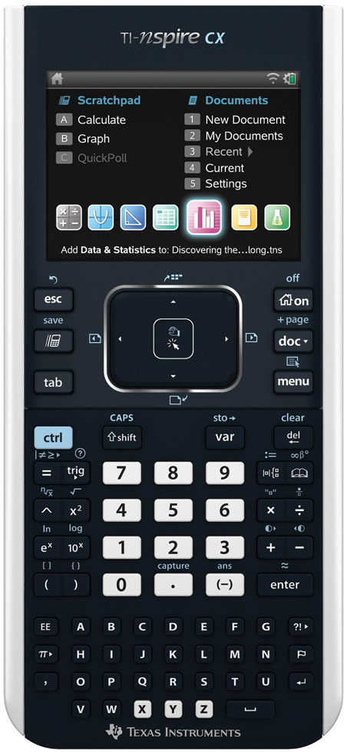
Let’s meet the TI-nspire CX
Turn on your CX
Select My Documents
Select the Chemistry Folder
Select GEAR UP Intro to CX file
Work through the activity
Not a Touch Screen

Slide 7
Questions

Slide 8
Have a Great rest of the day. See you tomorrow

Slide 9
Welcome Back! Everyone check in outside?

Slide 10
Agenda
Types of Data Collection
Fun with Fizzy Tablets experiment
Boyle’s Law experiment
Amontons’ Law demo
How Does it Stack simulation
Working with TI-Nspire Teacher Software
TI Education Website – education.ti.com
Density of Water lab
Homework
Exit Slip

Slide 11
Types of Data Collection
Meter View
Time-based
Rate of change – two point
Events with Entry

Slide 12
Fun with Fizzy Tablets
Look for handout located in your binder.
Follow the instructions on the handout.

Slide 13
Boyle’s Law
Gas pressure sensor
Notes:
Follow information in handout

Slide 14
Amontons’ Law
Demo
Notes:
Follow information in handout

Slide 15
How Does it Stack
Look for handout in your binder.
Be sure to follow the instructions on your handout.

Slide 16
TI-Nspire Teacher Software
Look for shortcuts on desktop
Don’t use CAS version
Start software

Slide 17
TI Education Website
www.education.ti.com
Point to Activities tab
Click on Science Nspired
Explore…
Point to Solutions tab
Click on Student and Parent Resources
Click on Learn More
Product Tutorials

Slide 18
Density of Water
Graduated cylinder, Water
Balance
Create a New Document…
Notes:
Follow information in handout

Slide 19
Homework
Find a Science Nspired file that you might use in the first 6 (or 9) weeks of next school year and load it on your computer.
Tomorrow you will be creating a tns file on the computer. Find an electronic image (either .jpg or .png) of something related to chemistry.

Slide 20
Exit Slip
Look for Exit Slip for Friday
Please fill it out
As honestly as possible ☺
After exit please fill out the following Google form: http://goo.gl/YNq97f

Slide 21
Welcome Back! Everyone check in outside?

Slide 22
Agenda
Review Exit Slips
Homework
Celsius to Fahrenheit lab
Bell Ringers
Waves and Spectrum Simulation
Thirst Quenchers lab
Freezing & Melting of Water lab
Creating a TNS file
Homework
Exit Slip

Slide 23
Review Exit Slips

Slide 24
Homework
Transfer your TNS file from last night to the handheld
Transfer that file to another person, not at your table, and discuss what you liked about the activity

Slide 25
Celsius to Fahrenheit
Working in pairs
Temp probe
Create a New document…

Slide 26
Bell Ringers
Science Nspired
Chemistry
Atomic Structure Section
Atomic Structure Module
Atomic Structure and Periodic Table – Bell Ringer
PublishView document

Slide 27
Waves and Spectrum
Download simulation from Atomic Structure module and load into handheld
Try it out on both PC and handheld
Notice any differences in running speeds
Now let’s edit the TNS file

Slide 28
Thirst Quenchers
Look for handout in your binder
Move bars in the bar graph
Color change in highlighted bar

Slide 29
Freezing & Melting of Water
Look for handout
Changing rate and experimental length
Transfer file to others in the group
Transfer file to computer
Screen capture of graph from DataQuest app

Slide 30
Creating a TNS file
Create New Document on computer
Split screen – Title/Image
MC – single response – self-check
Copy/Paste in page sorter view
Move pages in page sorter view
Share file with two others and discuss

Slide 31
Exit Slip
Look for Exit Slip for Saturday
Please fill it out
As honestly as possible ☺

